Slide 1
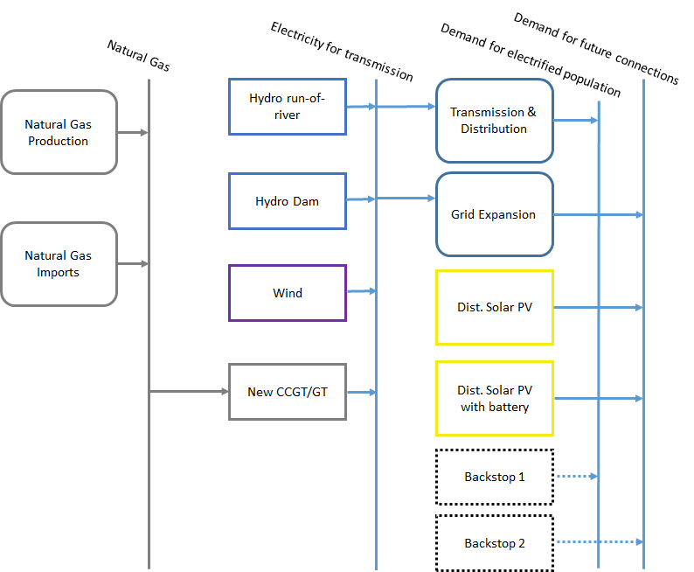
Primary energy supply technologies
Resources
Primary
Secondary
Final

Slide 2
Primary energy supply technologies
Resources
Primary
Secondary
Final

Slide 3
Primary energy supply technologies
Domestic extraction / production of fuels;
Import of fuels;
Fuels can be: coal, oil, oil products, natural gas, LNG, uranium, biomass, etc…

Slide 4
Primary energy supply technologies
They are typically represented in the Reference Energy System by a technology with only outputs (no inputs).
Coal
Coal extraction
Biomass production
Biomass
Natural gas
Natural gas import

Slide 5
Primary energy supply technologies
In OSeMOSYS, they are characterized by these parameters:
OutputActivityRatio: defines which fuel is provided and at what rate.
VariableCost [M$/PJ or M$/GWh]: cost of extraction or of import.
TotalTechnologyAnnualActivityUpperLimit or TotalTechnologyModelPeriodActivityUpperLimit [PJ or GWh]: define the level of proven reserves available for extraction, or the maximum quantity that can be imported.
Notes:
?? TotalAnnualMaxCapacity [GW]: defines the maximum annual rate of production

Slide 6
Primary energy supply technologies
In OSeMOSYS, they are characterized mostly by these parameters:
OutputActivityRatio: defines which fuel is provided and at what rate.
VariableCost [M$/PJ or M$/GWh]: cost of extraction or of import.
TotalTechnologyAnnualActivityUpperLimit or TotalTechnologyModelPeriodActivityUpperLimit [PJ or GWh]: define the level of proven reserves available for extraction, or the maximum quantity that can be imported.

Slide 7
Primary energy supply technologies
Examples
TotalTechnologyModelPeriodActivityUpperLimit [PJ or GWh]: define the level of proven reserves available for extraction, or the maximum quantity that can be imported, across the entire modelling period.
TotalTechnologyModelPeriodActivityUpperLimit = 100,000 PJ
Mozambique – Natural Gas proven reserves
100,000 PJ
Natural gas
Gas extraction
Mozambique

